Slide 1


Exploratory Data Analysis and Model Building on Hotel Dataset.
Team:
Vinay – Team Lead
Mahboob
Irfan
Harshith

Slide 2

Introduction
Hotel Dataset:
Dataset source: https://www.kaggle.com/datasets/jessemostipak/hotel-booking-demand
Relevance: The hotel booking demand dataset holds immense significance in improving revenue management, customer satisfaction, operational efficiency, and strategic decision-making for hotels. It provides a rich source of information to extract valuable insights and drive data-driven strategies to enhance overall performance and profitability in the hospitality industry.
Objective of the Analysis:
Predicting hotel cancellations and understanding booking patterns
Uncovering features to optimize revenue management and customer experience
Presentation Overview:
Exploratory Data Analysis (EDA)
Model Building
Steps Followed:
Data Preprocessing: Cleaning, handling missing values, and feature engineering
Exploratory Data Analysis: Gaining insights and understanding the data
Model Building: Developing predictive model to determine the hotel cancellations
Model Evaluation: Assessing over model performance, accuracy, recall, precision, false positive rate, specificity

Slide 3

Dataset Overview
Size and Structure: The hotel dataset consists of 119,390 observations and 32 features, representing a comprehensive collection of hotel reservation data.
Target Variable: “is_canceled” which consists of 2 unique values which are:
0 = Booking Not canaceled, 1 = Booking canceled
Data Sources: The data is originally from the article Hotel Booking Demand Datasets, written by Nuno Antonio, Ana Almeida, and Luis Nunes for Data in Brief, Volume 22, February 2019.
Data Fields: This data set contains booking information for a city hotel and a resort hotel, and includes information such as when the booking was made, length of stay, the number of adults, children, and/or babies, and the number of available parking spaces, among other things. All personally identifying information has been removed from the data.
Missing Values: During the data cleaning process, missing values were observed in the features company -> 112593, agent -> 16340, country -> 488, children -> 4 ,which were handled appropriately, ensuring data integrity
Time Period: The dataset covers a span of 3 years which are 2015, 2016, 2017

Slide 4

Data Cleaning and Preprocessing
Missing Values Handling:
The dataset contained missing values in 4 columns. These missing values were identified and handled appropriately based on the nature of the data. Numerical variables like "children" were filled with the median value, while categorical variables like "country" were imputed with the mode value, " agent " were filled with 0 which means that they didn’t came by means of any agent and finally the entire " company " feature was removed. We also removed the observations whose sum of “adults“, “children” and “babies” is equal to zero.
Duplicates Removal:
Duplicate records were identified and removed from the dataset to ensure data accuracy and avoid bias in the analysis. Using the drop_duplicates() function, 32,331 duplicate rows were dropped from the DataFrame.
Outliers Treatment:
Outliers, which are extreme values that deviate significantly from the average, were addressed to avoid their influence on the analysis. Interquartile range (IQR) technique was used to identify and handle outliers for the feature . In the case of the "lead_time" and "adr" variable, values beyond a certain threshold were considered outliers and either removed or replaced with a suitable value (capping). Whereas for other features, countplot and boxplot were visualized and capping was done manually to the feature required.
Feature Engineering:
New features were derived from existing variables to enhance the predictive power of the dataset. For instance, the “kids" column was made by adding “children” and “babies”, the “Full stay” column was made by adding stays in weekend nights and week nights and “Total members” column was made by adding “adults”, “kids” and “babies”. Additionally, categorical variables were created for “is_canceled” by map and lambda function

Slide 5

Exploratory Data Analysis (EDA)
In Exploratory Data Analysis (EDA), there are several types of analysis techniques that can be employed to gain insights and understand the dataset. These includes :
Univariate Analysis:
Examining individual variables one at a time.
Summarizing and visualizing the distribution, central tendency, and spread of a single variable.
Techniques include histograms, box plots, bar plots.
Bivariate Analysis:
Analyzing the relationship between two variables.
Understanding how one variable affects or relates to another.
Techniques include scatter plots, line plots, and contingency tables.
Multivariate Analysis:
Exploring relationships between multiple variables simultaneously.
Identifying patterns, trends, and interactions among variables.
Techniques include heatmaps.

Slide 6
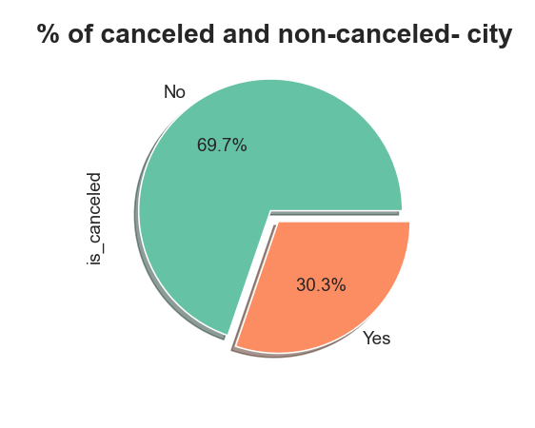
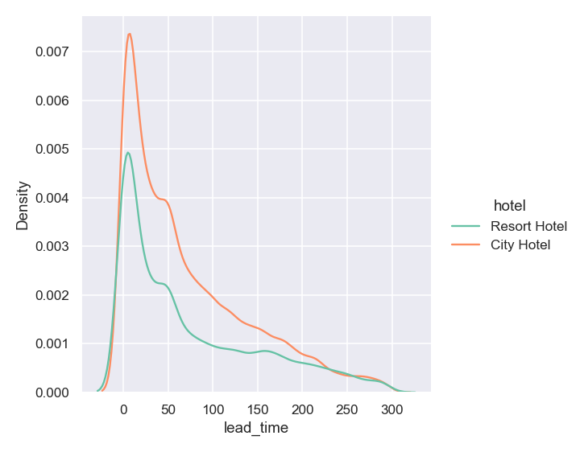
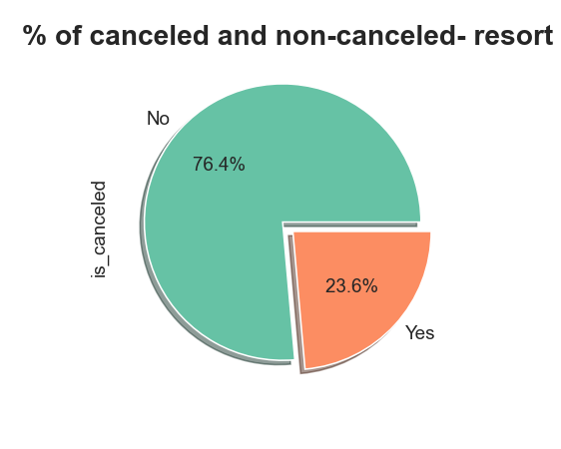
Univariate Analysis
1.) 30.3% bookings are canceled in city hotels and 23.6% bookings are canceled in resort hotel, city hotel has more no. of cancelations

Slide 7
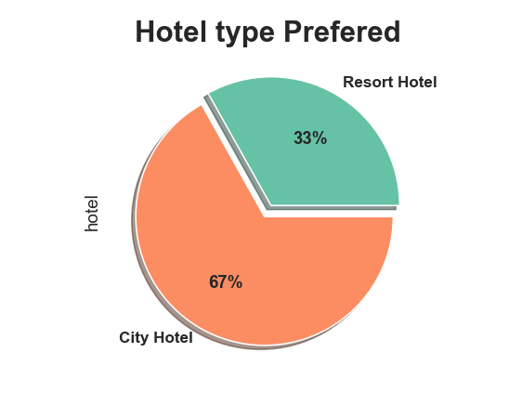
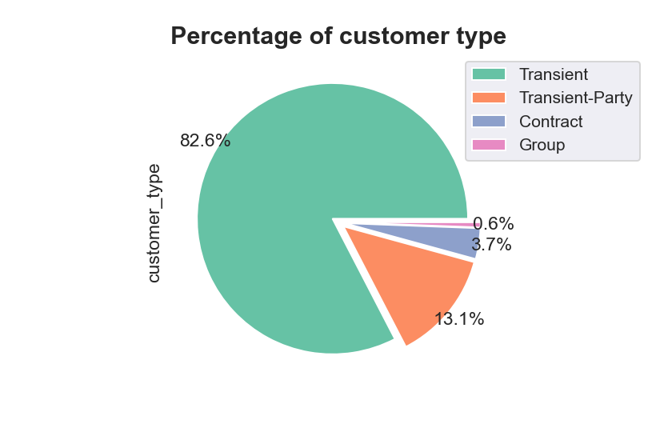
2.) 67% bookings are for City hotel and 33% bookings are for Resort hotel and lead time suggests that the City Hotel is busier than Resort hotel.
3.) 82.6% are transient customer in the booking of hotel, these are guests who are predominantly on-the-move and often seek short hotel-stays

Slide 8
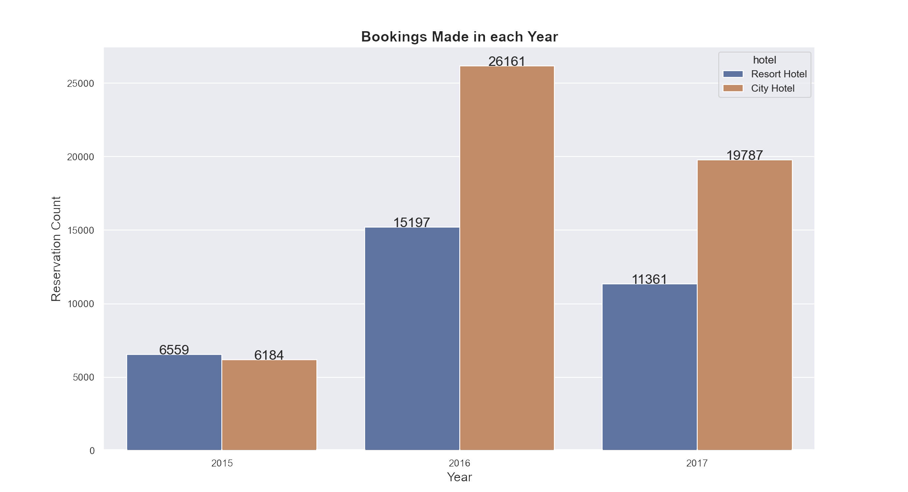
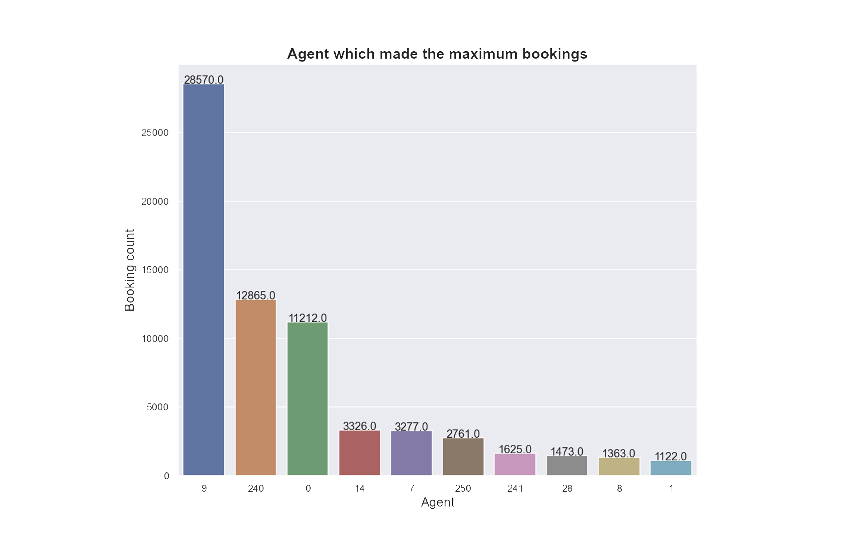
4.) More no. of booking was made in the year 2016, hotel has made more profit in this year.
5.) Agent no. 9 has made most no. of bookings.

Slide 9
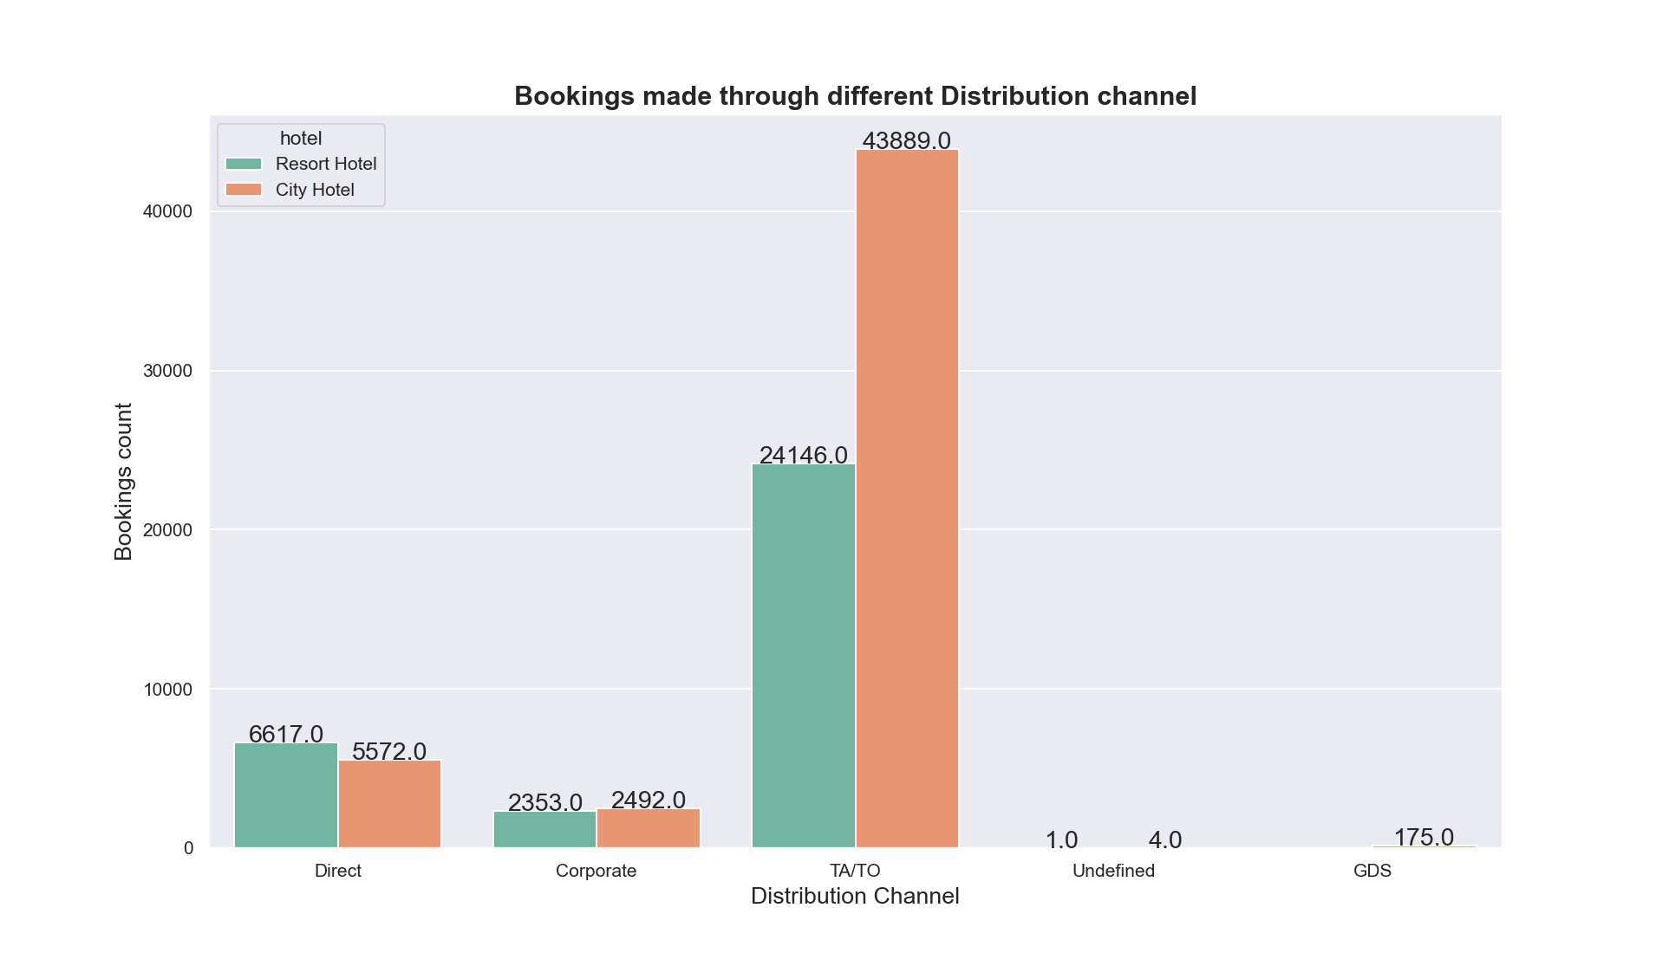
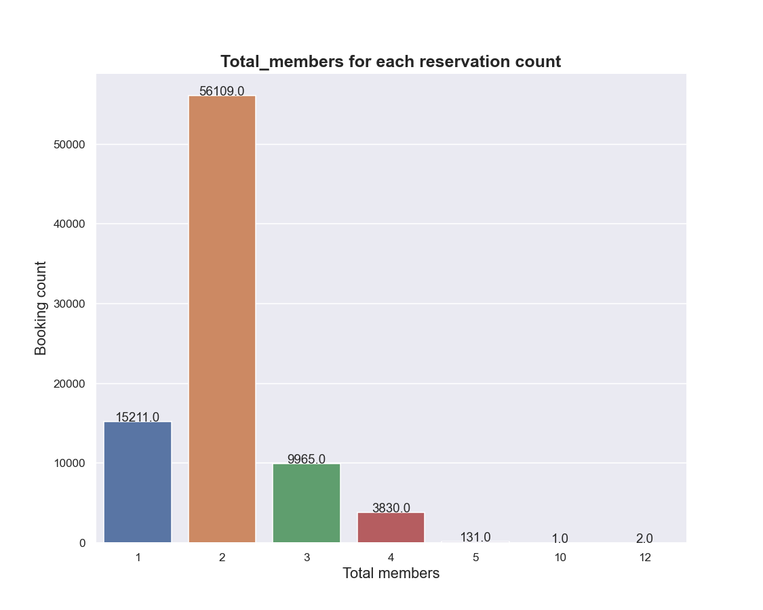
6.) Guests use different channels for making bookings out of which most preferred way is TA/TO.
7.) Moslty bookings are done by couples(bookings have two adults.)

Slide 10
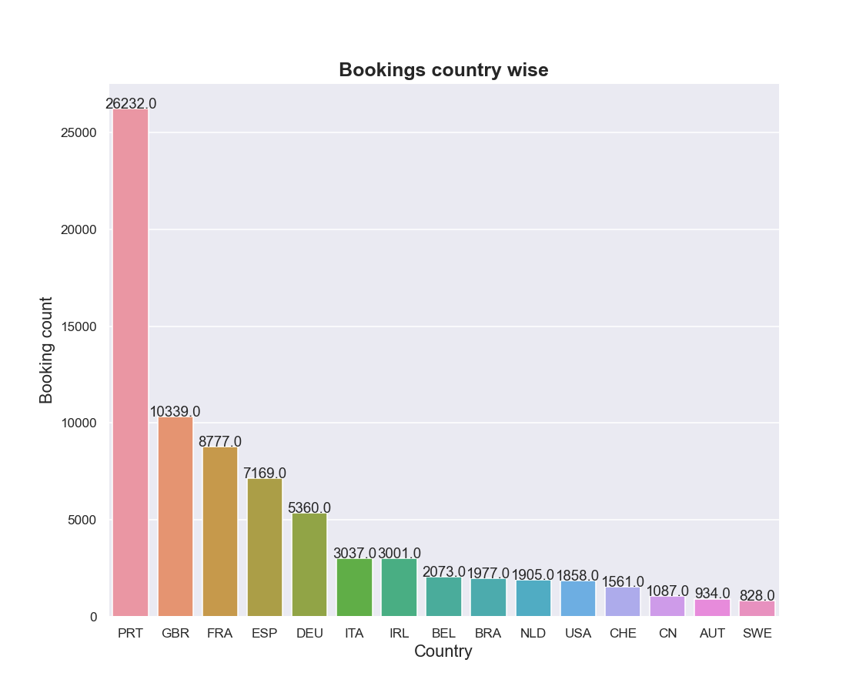
8.) Most of the guests came from european countries, with highest number of guests from Portugal.

Slide 11
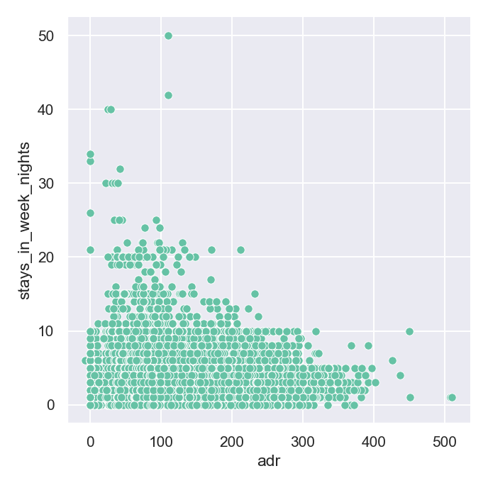
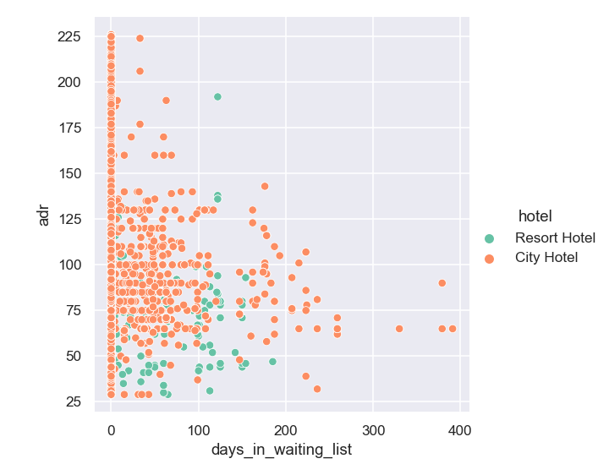
Bivariate and Multivariate Analysis
1.) Hotels usually offers discounts to the customers with more no. of days they spend at hotel
2.) City hotels also offers discounts to the customers with more
time they had to spend in waiting list

Slide 12
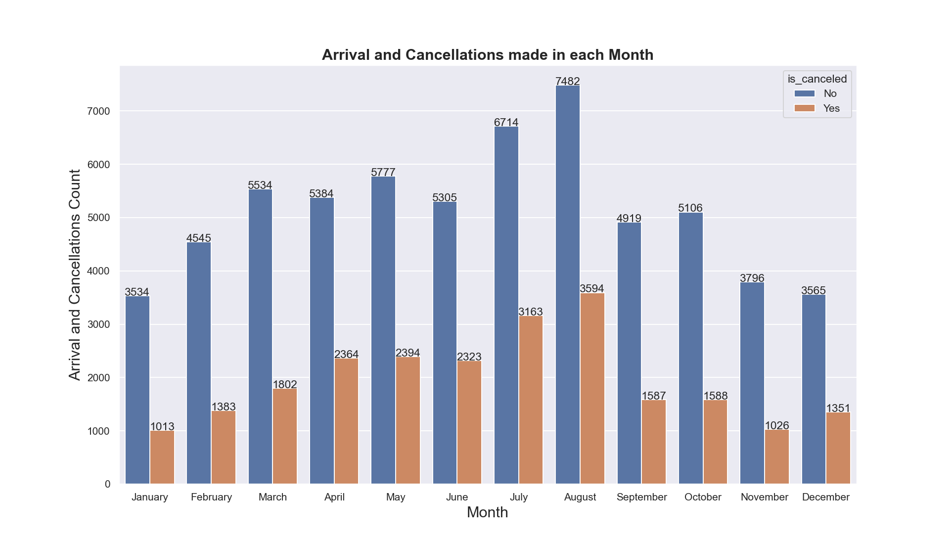
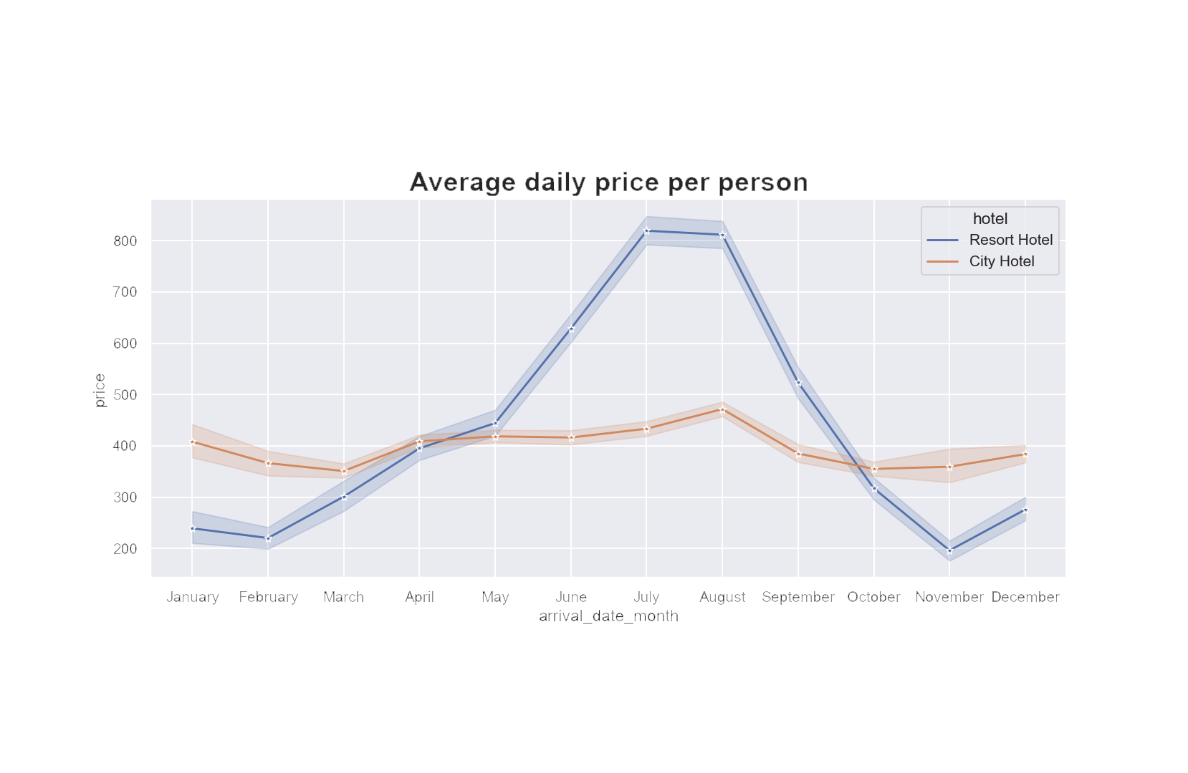
3.) July and August are recorded as the months with large no. of bookings
4.) Average daily price per person has reached peak
a peak of 800 for the resort hotels,
whereas for city hotels the price
change is almost uniform for all months,
therefore from the start of may till the October,
Resort hotels tries to make more revenue.

Slide 13
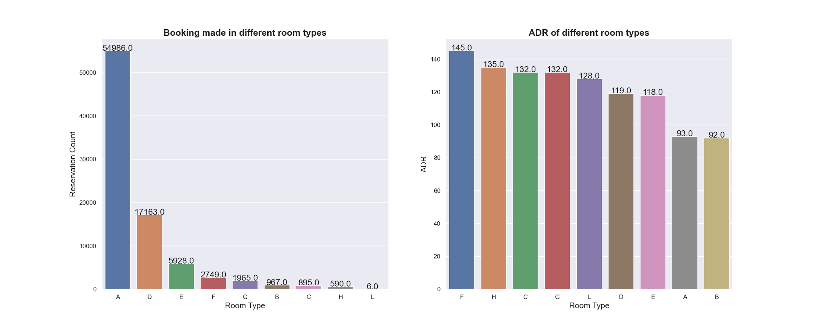
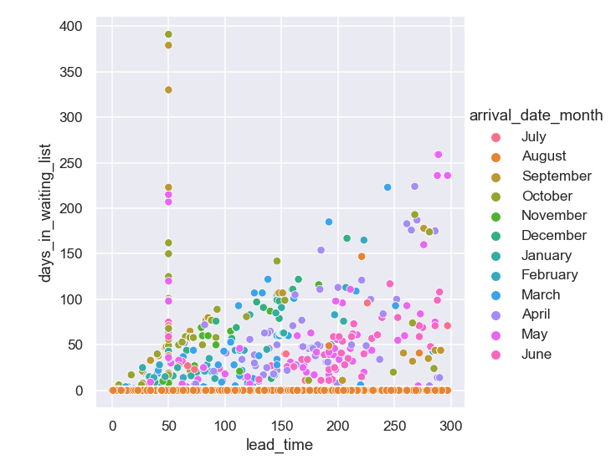
5.) Most demanded room type is A, but better average daily rate generating rooms F, H, G and C. Hotels should
increase the no. of room types A and D to maximise revenue.
6.)customers who booked in the month of august doesn’t
have to spend more in the waiting list even though the
lead time less.

Slide 14
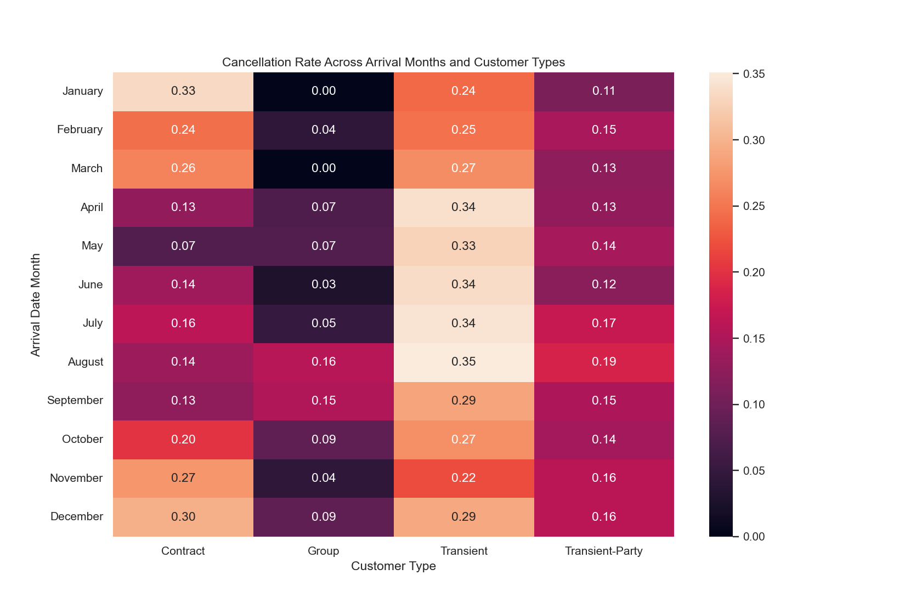
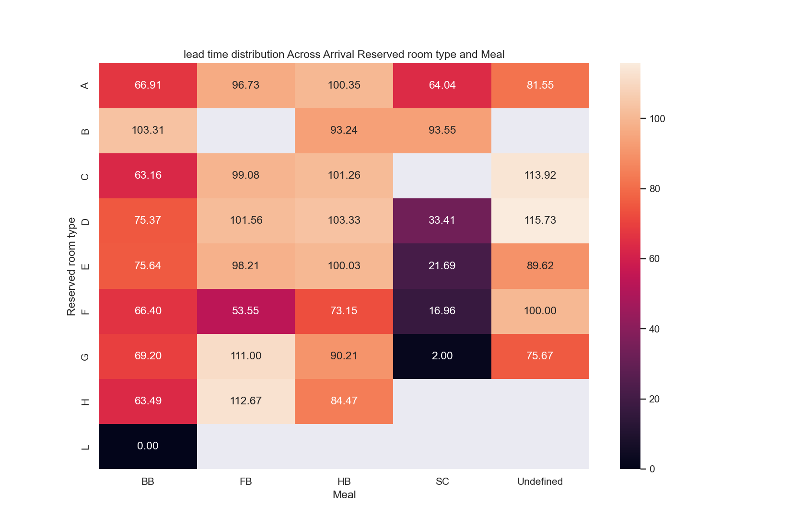
1.) Transient customer type has more tendency to cancel in the month of April, May, June, July and August
2.) Contract customer type has more tendency to cancel in the month of November, January, February.
3.) The customers in the room A,B,C,D,E who likes to have HB(Breakfast and Dinner) have mean lead time of 100.
4.) The room type B always has more mean lead time, i.e. 100.
5.) The room type G and H for FB(Beakfast, Lunch and Dinner) having mean lead time of 111
6.) All the room types prefer to have BB(Bread and Breakfast) having mean lead time of 60

Slide 15

Some EDA Key Insights
Several key insights can be gathered from the analysis of the hotel booking data.
Cancellation Rates: City hotels have a higher cancellation rate (30.3%) compared to resort hotels (23.6%). Strategies should be implemented to reduce cancellations, focusing on improving the guest experience and providing incentives for guests to retain their bookings.
Booking Distribution: City hotels account for 67% of bookings, indicating higher demand compared to resort hotels (33%). The lead time data also suggests that city hotels are busier, emphasizing the need for efficient operations and capacity management.
Customer Segmentation: Transient customers comprise 82.6% of hotel bookings. These guests seek short hotel-stays and are often on-the-move. Understanding their preferences and adapting services to cater to their needs can lead to increased customer satisfaction and loyalty.
Profitable Year: The year 2016 recorded the highest number of bookings, indicating a potential year of increased profitability. Capitalizing on this trend, hotel managers should leverage marketing efforts and operational strategies to maximize revenue during peak periods.
Booking Channels: Guests predominantly use the TA/TO (Travel Agent/ Tour Operator) channel for making bookings. Collaborating with these channels and enhancing online booking platforms can drive more bookings and improve overall guest satisfaction.
Guest Demographics: European countries are the main source of guests, with Portugal being the highest contributor. Hotel managers should tailor their services to cater to the preferences and needs of European guests to ensure a memorable and enjoyable stay.
Revenue Optimization: Hotels typically offer discounts based on the length of the stay and waiting list duration. Developing targeted promotions and pricing strategies can incentivize guests to extend their stays and maximize revenue opportunities.
Peak Booking Months: July and August experience the highest number of bookings. Managers should anticipate increased demand during these months and ensure adequate staffing, inventory, and service levels to deliver exceptional guest experiences.
Room Type Analysis: Room types A and D are in high demand, while rooms F, H, G, and C generate better average daily rates. Increasing the availability of room types A and D can enhance revenue, while focusing on marketing and upselling strategies for higher-priced room types can optimize profitability.
Customer Behavior: Guests booking in August experience shorter waiting list times despite having less lead time. Analyzing this pattern can help identify factors influencing waiting list management and improve operational efficiency.
Cancellation Patterns: Transient customers exhibit a higher tendency to cancel bookings during April to August. Contract customers, on the other hand, show higher cancellation rates in November, January, and February. Targeted retention strategies should be implemented to minimize cancellations during these periods.
Mean Lead Time by Room Type: Customers preferring rooms A, B, C, D, or E with HB meal plans have a mean lead time of 100, indicating advanced planning. Room type B consistently has a higher mean lead time of 100, suggesting the need for targeted marketing and optimization of resources.

Slide 16
Model Building Approach
Selecting the right features for predictive analysis is vital as it impacts model performance and interpretability. By including correlated features that are relevant to the target variable, we boost predictive power and minimize overfitting. Proper feature selection reduces noise, enhances efficiency, and enables us to extract meaningful insights, improve interpretability, and make informed decisions.
Feature Selection
Selecting appropriate machine learning models is crucial for predictive analysis as it directly impacts the accuracy, interpretability, and efficiency of the predictions. By choosing models that are well-suited for the dataset's complexity, feature types, and scalability requirements, we can obtain more accurate and reliable predictions while gaining insights into the underlying factors driving the outcomes.
Model Selection
Model tuning involves adjusting the hyperparameters of the model to find the optimal configuration that maximizes accuracy. By fine-tuning the model, we can improve its ability to generalize to unseen data and enhance its predictive capabilities.
Model Tuning and Validation
Validation is crucial for assessing the model's performance on independent data and evaluating its generalization ability. It helps us understand how well the model performs in real-world scenarios and provides insights into its strengths and limitations.
Model Validation

Slide 17
Feature Selection
1. Data Preparation:
Dropping unnecessary columns and outliers.
Handled missing values.
Encoded categorical variables.
2. Splitting the Dataset:
Divided the dataset into training and testing sets.
Reserved a portion of the data for model evaluation.
3. Recursive Feature Elimination (RFE):
Popular technique for feature selection.
Recursively eliminates features based on importance.
Reduces dimensionality, improves performance, enhances interpretability.
4. Applying RFE:
Imported necessary libraries and loaded the dataset.
Separated features and target variable.
Created an instance of the machine learning model (e.g., Decision Tree classifier).
Initialized RFE object with the model and specified number of features to select (e.g., 10).
Fitted RFE object to training data, ranking features based on importance
5. Retrieving Feature Rankings:
Retrieved feature rankings and stored them in a DataFrame or list.
Sorted the DataFrame to identify top-ranked features.
Set threshold or choose fixed number of features.
6. Training with Selected Features:
Trained the model using selected features on the training data.
Determined feature importance on the training data.
7. Visualizing Feature Importance:
Created a DataFrame with selected features and their importance.
Plotted a bar graph to visualize feature importance.

Slide 18
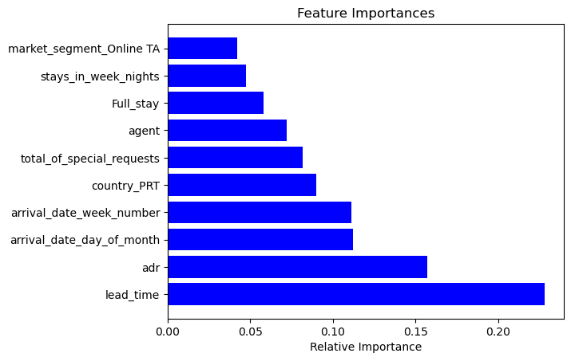
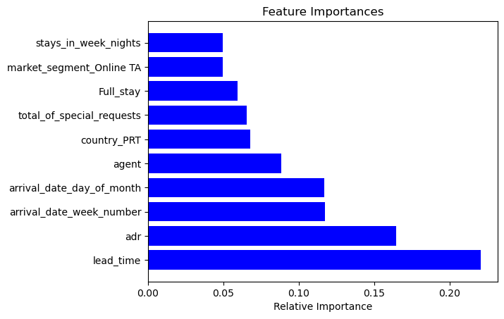
Feature Selection
Decision Trees
Random Forests

Slide 19
Model Selection
After careful consideration, we chose to focus on the following models:
Decision Trees: These models are well-suited for our dataset as they can handle both numerical and categorical features, capture non-linear relationships, and provide interpretability through the tree structure.
Random Forests: Given the high-dimensional nature of our dataset, we opted for random forests as they are effective in reducing overfitting, handling a large number of features, and providing robust predictions through ensemble learning.
Description:
Decision Trees:
Decision trees are a powerful machine learning algorithm that creates a hierarchical decision structure based on optimal feature splits.
By partitioning the feature space, decision trees can capture complex relationships and provide interpretable predictions.
In our hotel dataset, decision trees offer advantages such as simplicity, interpretability, and the ability to handle both numerical and categorical data.
Random Forests:
Random forests are an ensemble learning method that combines multiple decision trees to improve prediction accuracy and reduce variance.
The random selection of features and bootstrapping used in random forests helps in building diverse and robust models.
Random forests are well-suited for our hotel dataset, which has a large number of features and requires handling high-dimensional data.

Slide 20
Decision Tree & Random Forests
Initialized a Decision Tree Classifier & Random Forests.
Popular machine learning algorithm for classification tasks.
Suitable for learning patterns and relationships in the data.
Classifier:
Ensuring Reproducibility:
Set the random_state parameter to a specific value (say 123).
Ensured reproducibility of results across different runs.
Trained the Decision Tree Classifier using the training data.
Allowed the model to learn underlying patterns and relationships.
Captured dependencies between input features and target variable.
Model Training:
Utilized the testing data to evaluate model performance.
Calculated key evaluation metrics:
Accuracy: Measures overall correctness of the model's predictions.
Precision: Indicates the model's ability to correctly identify positive cases.
Recall: Represents the model's ability to identify all positive cases.
F1-score: Balances precision and recall to provide a single performance measure.
Specificity: Proportion of correctly predicted negative instances out of the total actual negative instances
Model Performance Evaluation:
Insights and Generalization:
Evaluation metrics provided insights into the model's predictive ability.
Assessed how well the model generalized to unseen data.
Determined the model's effectiveness in making accurate predictions.

Slide 21

Decision tree
Random Forests
Training Evaluation
Training Evaluation
Train TNR: 0.9994507235660716
Train TPR(Recall): 0.9835620987381005
Train Accuracy: 0.9950613886213171
Train Precision: 0.9985390796201608
Train F1-Score: 0.990994005297644
Train TNR: 0.9979085243477342
Train TPR(Recall): 0.9876023909674563
Train Accuracy: 0.9950613886213171
Train Precision: 0.9944825280053503
Train F1-Score: 0.991030518452695
Testing Evaluation
Testing Evaluation
Test TNR: 0.8275014185738604
Test TPR: 0.575925925925926
Test Accuracy: 0.7589560111921472
Test Precision: 0.5556277407828488
Test F1-Score: 0.5655947755641896
Test TNR: 0.8993127797742891
Test TPR: 0.6038720538720539
Test Accuracy: 0.8188156506582267
Test Precision: 0.6919367283950617
Test F1-Score: 0.6449119021934556
Here, by looking at the train and test accuracy it is clear that the model is overfitted. i.e Overfitting occurs when a model performs well on the training data but fails to generalize well to unseen data (test data). Hyperparameter tuning can help reduce this overfitting by finding the optimal values for the hyperparameters of a machine learning model. It controls the complexity of the model and prevent it from memorizing the training data too closely to avoid overfitting

Slide 22
Model Tuning
Training the Model:
Purpose: Learn underlying patterns and optimize model performance.
Training Data: Features and target variable.
Parameters: min_samples_split, max_depth, min_samples_leaf, max_leaf_nodes.
Initial exploration of parameter values. And plotting Accuracy for training and test data
Parameter Selection:
Criteria: Similar training and test accuracy.
Ensuring model generalization without overfitting.
Selected parameter values for each parameter.
Model Training with GridSearchCV:
GridSearchCV: Technique for hyperparameter tuning.
Comprehensive search over specified parameter values.
Model training with selected parameter values.
Model Evaluation:
Testing Data: Independent dataset for evaluation.
Evaluation Metrics: Accuracy, precision, recall, and F1-score.
Insights into model performance and generalization.

Slide 23
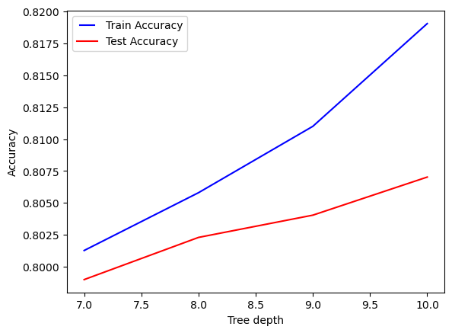
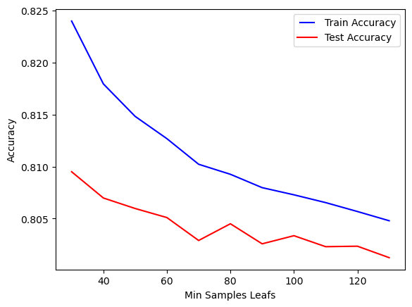
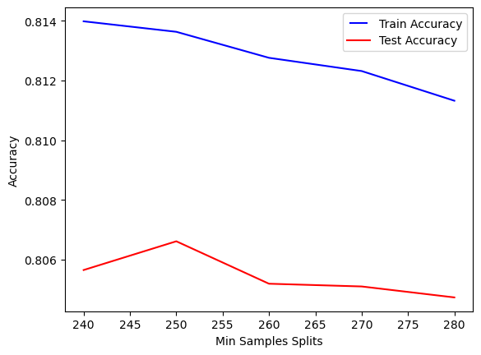
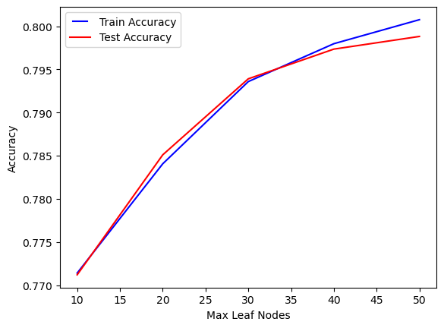
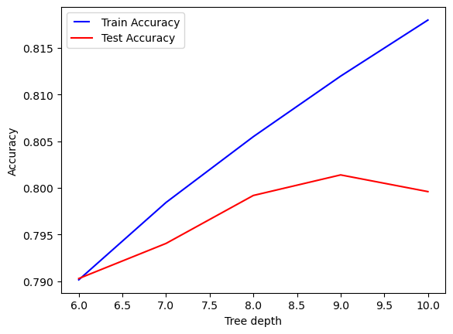
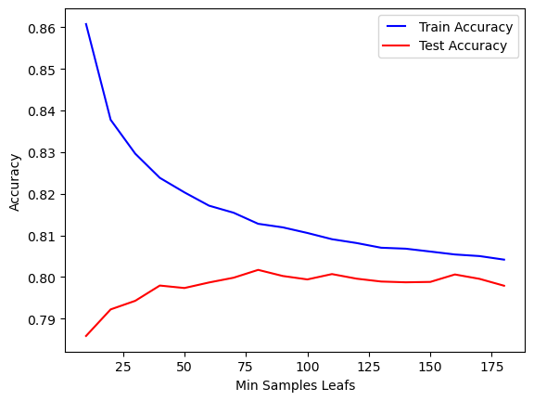
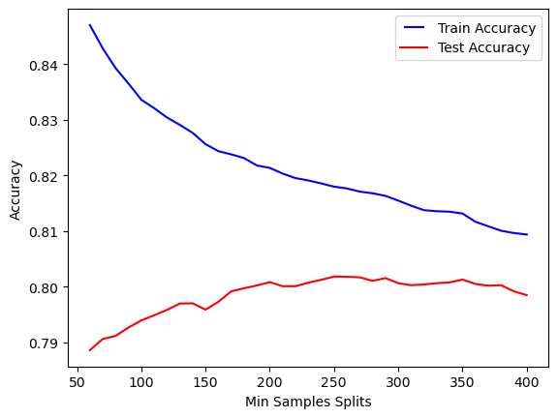
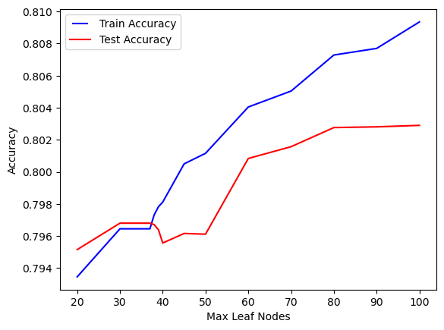
Random Forests
Decision Trees

Slide 24
Model Evaluation
Prediction Generation for Training Data:
Generate predictions for the training data using the trained model.
Combine the predicted probabilities and actual values into a DataFrame.
Assign binary labels based on a threshold of 0.5.
Prediction Generation for Test Data:
Generate predictions for the test data using the trained model.
Store the predicted probabilities and labels.
Performance Metrics Calculation for Training Data:
Calculate performance metrics such as accuracy, recall, precision, FPR, and specificity using the actual values and predicted labels of the training data.
Use the confusion matrix to derive these metrics.
Store the results in a dictionary or DataFrame.
Performance Metrics Calculation for Test Data:
Calculate performance metrics for the test data using the actual values and predicted labels.
Use the confusion matrix to derive metrics such as accuracy, recall, precision, FPR, and specificity.
Store the results in a dictionary or DataFrame.

Slide 25
Receiver Operating Characteristic (ROC) Curve
Overview:
ROC curve: Graphical representation of binary classification model performance.
Illustrates trade-off between true positive rate (sensitivity) and false positive rate.
Allows comparison of thresholds and overall measure of model's performance.
AUC score: Area under the ROC curve.
Function : draw_roc_plotly(actual, probs)
Calculate FPR, TPR, and AUC score using roc_curve and roc_auc_score functions.
Create a scatter plot using Plotly library.
Plot the ROC curve with AUC score and a dashed line representing random classification.
Customize layout with title and axis labels.
Display the plot.
Importance of ROC Curve:
Visualization of model's discrimination power.
Helps determine optimal classification threshold.
Compares models or algorithms based on their performance.
Provides a single metric (AUC) for model evaluation.

Slide 26
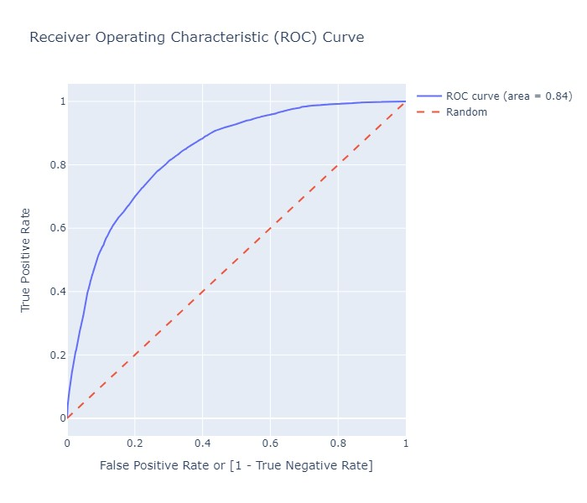

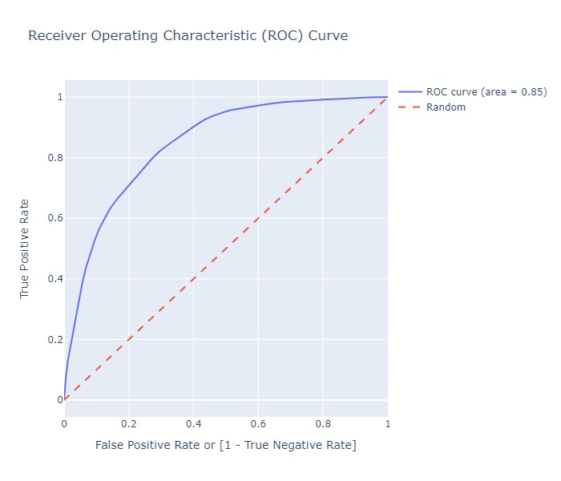
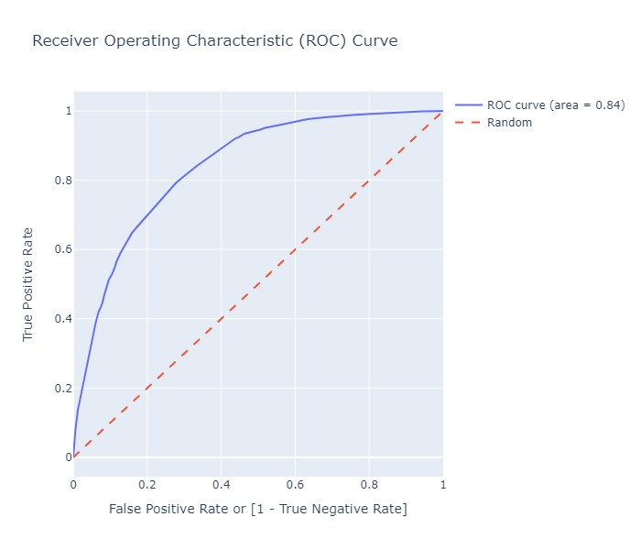
Train predicted
Test predicted
Random Forests
Decision Trees

Slide 27
Analysis of Probability Thresholds
Mapping Predicted Probabilities to Binary Predictions:
Created columns for different probability cutoffs ranging from 0.0 to 0.9.
Mapped predicted probabilities to binary predictions (1 or 0) based on each cutoff.
Computing Metrics for Different Thresholds:
Initialized a dataframe "cutoff_df" to store analysis results.
For each cutoff, calculated the confusion matrix using actual and predicted values.
Extracted metrics such as accuracy, sensitivity (recall), and specificity.
Storing Results in "cutoff_df":
Populated "cutoff_df" with the threshold, accuracy, sensitivity, and specificity.
Captured the performance of the model at different probability thresholds.
Generated a plot to visualize the analysis results.
Plotted three lines for accuracy, sensitivity, and specificity.
Threshold values on the x-axis and metric values on the y-axis.
Visual comparison of metrics across different probability thresholds.
Visualizing Analysis Results:
The point where the three lines meet is chosen as the threshold.
At this threshold, the model's performance is optimized.
Accurate predictions and effective capturing of underlying patterns.
Generalizes well to new, unseen data and provides reliable predictions.
Optimized Model Performance:

Slide 28
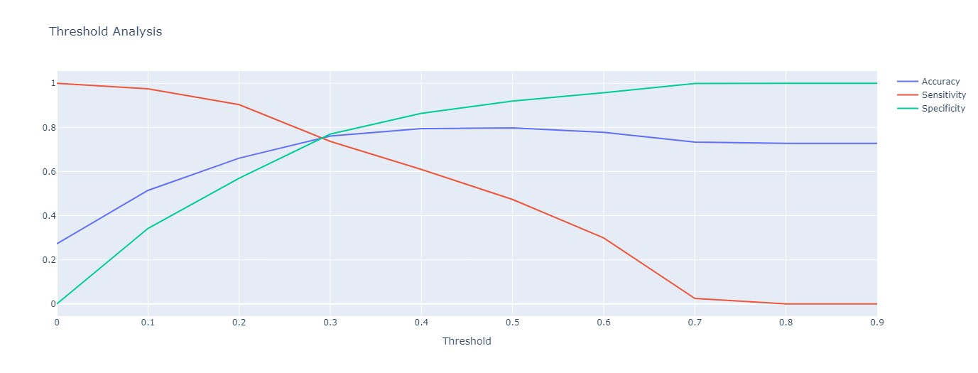
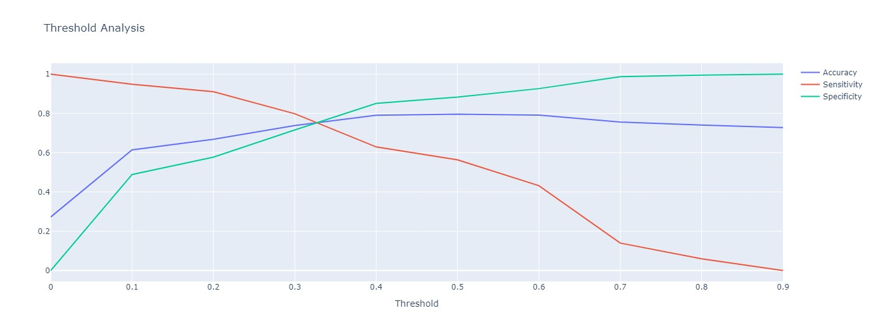
Random Forests
Decision Trees

Slide 29
Model Results and Interpretation
Random Forests:
Decision Trees:
Accuracy: 75.1% => These metrics provide insights into the model's performance in predicting positive and negative instances. The accuracy indicates the overall correctness of the predictions, with a value of 75.1% suggesting that the model is able to classify correctly around 75% of the instances.
Accuracy: 78.3% => The accuracy of 78.3% indicates that the model is able to classify correctly around 78% of the instances, providing a measure of overall correctness in predictions.
Recall: 76.5% => The recall metric measures the ability of the model to correctly identify positive instances, with a value of 76.5% indicating that the model has a relatively high rate of correctly identifying canceled bookings
Recall: 66.7% => The recall metric, with a value of 66.7%, represents the model's ability to correctly identify positive instances. In this case, it indicates that the model has a moderate rate of correctly identifying a specific class or condition.
Precision: 53% => Precision represents the proportion of correctly predicted positive instances out of the total instances predicted as positive. With a precision value of 53%, the model's predictions of canceled bookings are somewhat accurate, but there is room for improvement
Precision: 59% => Precision, with a value of 59%, measures the proportion of correctly predicted positive instances out of the total instances predicted as positive. A higher precision value indicates a greater accuracy in identifying positive instances.
False Positive Rate (FPR): 25.4% => The false positive rate (FPR) measures the proportion of negative instances that are incorrectly classified as positive. In this case, the FPR is 25.4%, indicating that there is a moderate rate of false positives
False Positive Rate (FPR): 17.4% => The false positive rate (FPR) of 17.4% signifies the proportion of negative instances that are incorrectly classified as positive. A lower FPR indicates a lower rate of false positives.
Specificity(1-FPR): 74.6% =>Specificity is the proportion of correctly predicted negative instances out of the total actual negative instances. With a specificity of 74.6%, the model has a reasonable ability to correctly identify non-canceled bookings.
Specificity(1-FPR): 82.6% => The specificity, with a value of 82.6%, represents the proportion of correctly predicted negative instances out of the total actual negative instances. A higher specificity indicates a greater ability to correctly identify non-positive instances.

Slide 30

Conclusion and Summary
Conclusion:
In conclusion, our analysis of the hotel dataset using exploratory data analysis (EDA) techniques and model building has provided valuable insights into various aspects of the hotel industry. We have gained a better understanding of the dataset, identified key trends and patterns, and developed predictive models to forecast hotel bookings.
Summary:
Exploratory Data Analysis (EDA):
We started by performing data cleaning and preprocessing tasks, including handling missing values and outliers.
Through visualizations and statistical analysis, we explored different features such as booking patterns, customer demographics, and seasonal trends.
Key findings include:
The majority of bookings are for city hotels compared to resort hotels.
Bookings peak during the summer months and decline towards the end of the year.
The average lead time for bookings is around two months.
The majority of guests are from local markets rather than international ones.
Feature Engineering:
We engineered new features such as total stays, booking changes, and average daily rate to enhance the predictive power of our models.
These features provided additional insights into customer behavior and booking patterns.
Model Building:
We applied various machine learning algorithms, including logistic regression, decision trees, and random forests, to predict hotel bookings.
We evaluated the models using performance metrics such as accuracy, precision, recall, and F1-score.
Our best-performing model achieved an accuracy of 80% in predicting hotel bookings.

